Slide 1
Immediate Patient Recovery System

Slide 2
Problem Statement
A lot of time and effort is spent in gathering information about the health history of a patient before treating him. In times of accidents or critical situations which require immediate response from the doctors a lot of time is spent in collecting the medical history of the patient. Also, sometimes a doctor ends up giving wrong treatment to a person due to unawareness of the allergies a person has.
If there is a centralized system to store all the information related to the health history of a patient as well as information to related to any organ requirement of patients, it will solve many critical problems in the medical world.
To avoid effort of the patient in a critical condition , pre-available insurance plans according to the eligibility of patient will be available for the doctor to map.

Slide 3
Approach
To achieve the objective of this project we are using an Eco-system model.
This model has
Enterprises - Blood bank, Hospital, Insurance, Organ donation, Lab.
Organizations- Insurance Manager, Doctor, Hospital Inventory Manager,
Blood Bank Inventory Manager, Organ Donation Inventory Manager,
Lab Assistant.
Roles- Doctor, Insurance Manager, Inventory Manager, Organ Donation org. Manager, Hospital Admin, System Admin, Lab Assistant, Blood Bank Admin, Blood Bank Inventory Manager, Lab Admin.

Slide 4
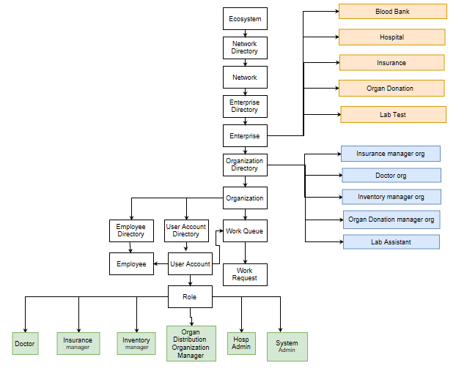
Object Model:

Slide 5
Use cases

Slide 6
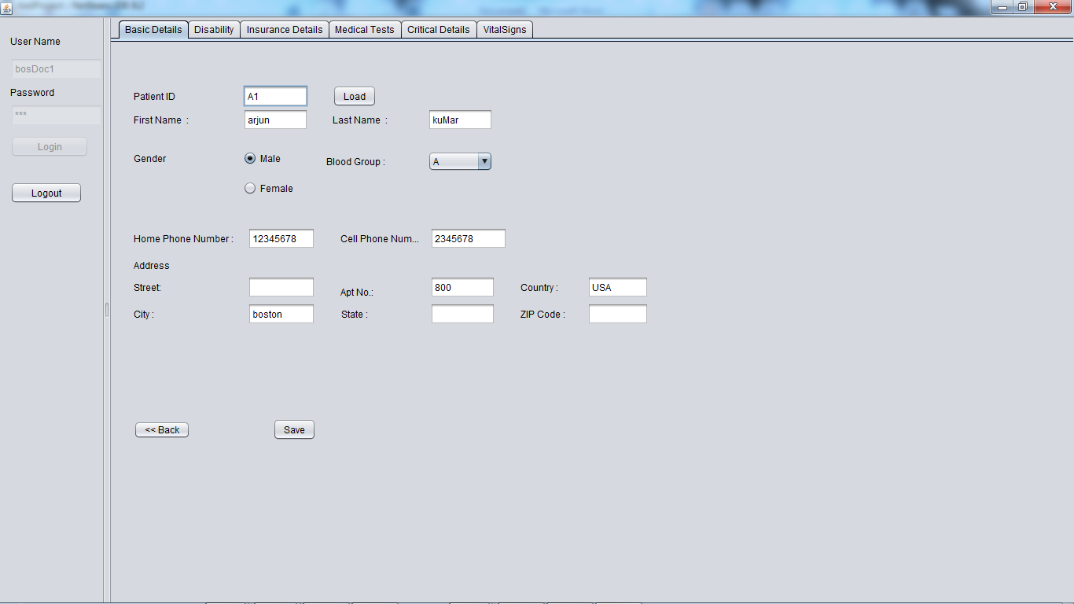
Doctor Work Area:

Slide 7
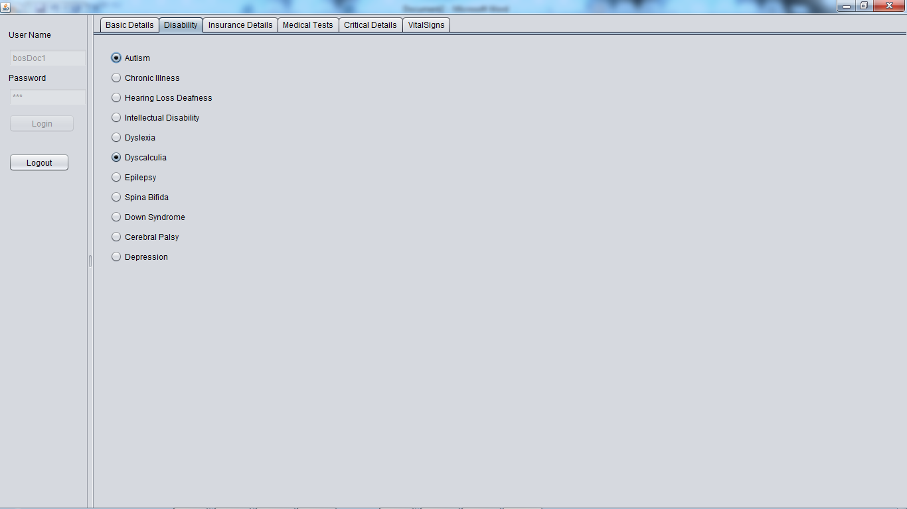

Slide 8
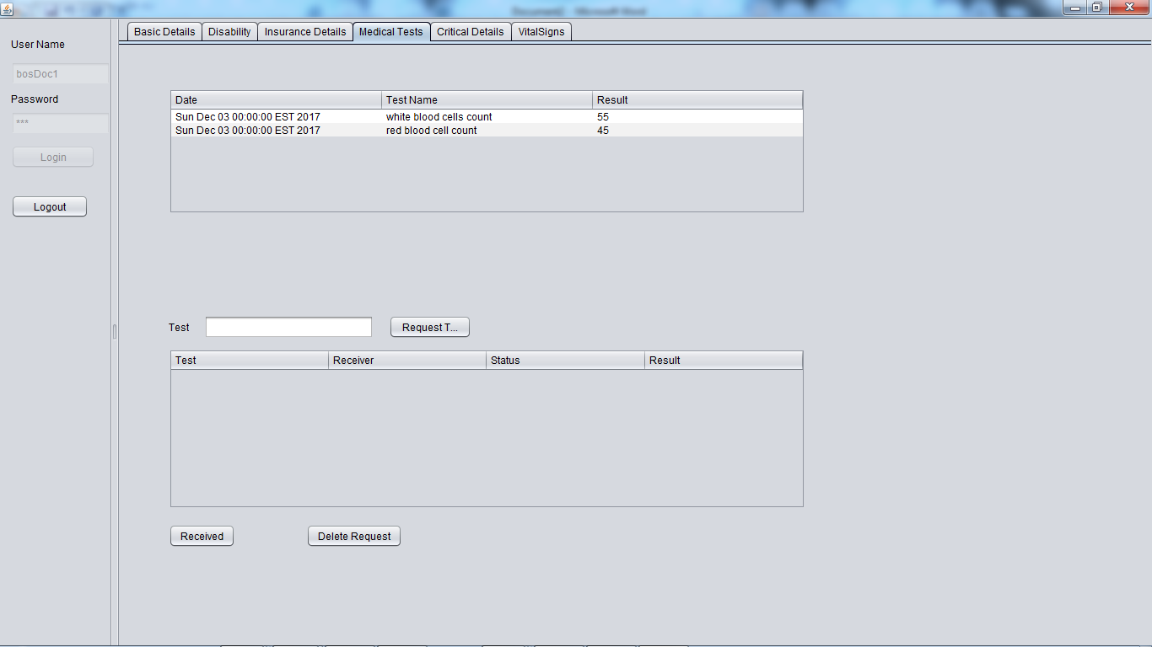

Slide 9
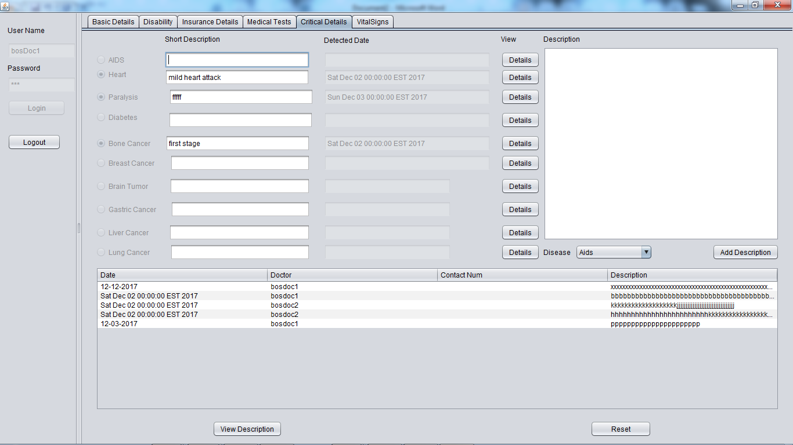

Slide 10
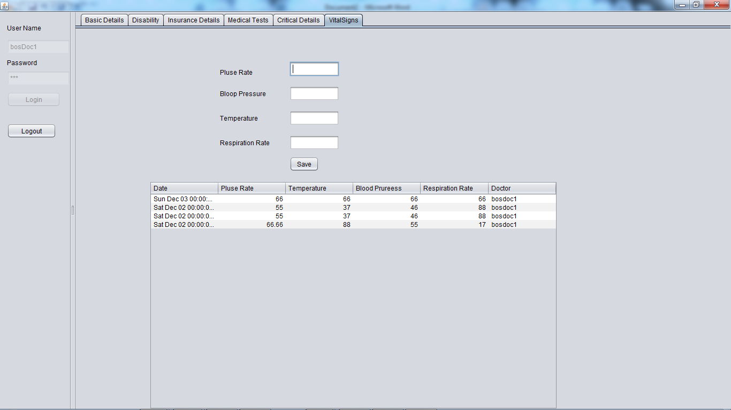

Slide 11
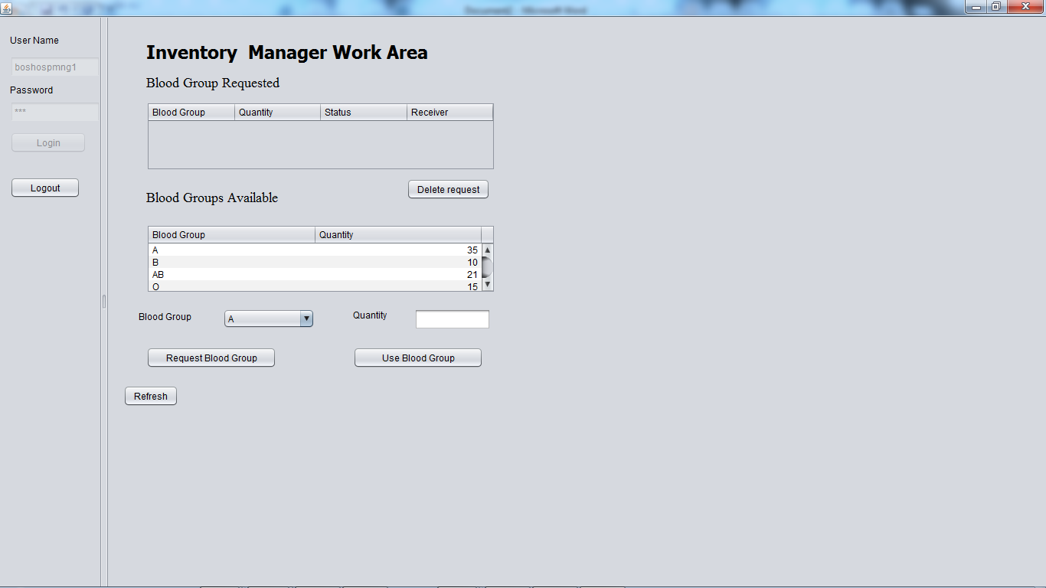
Hospital Inventory Manager Workarea

Slide 12
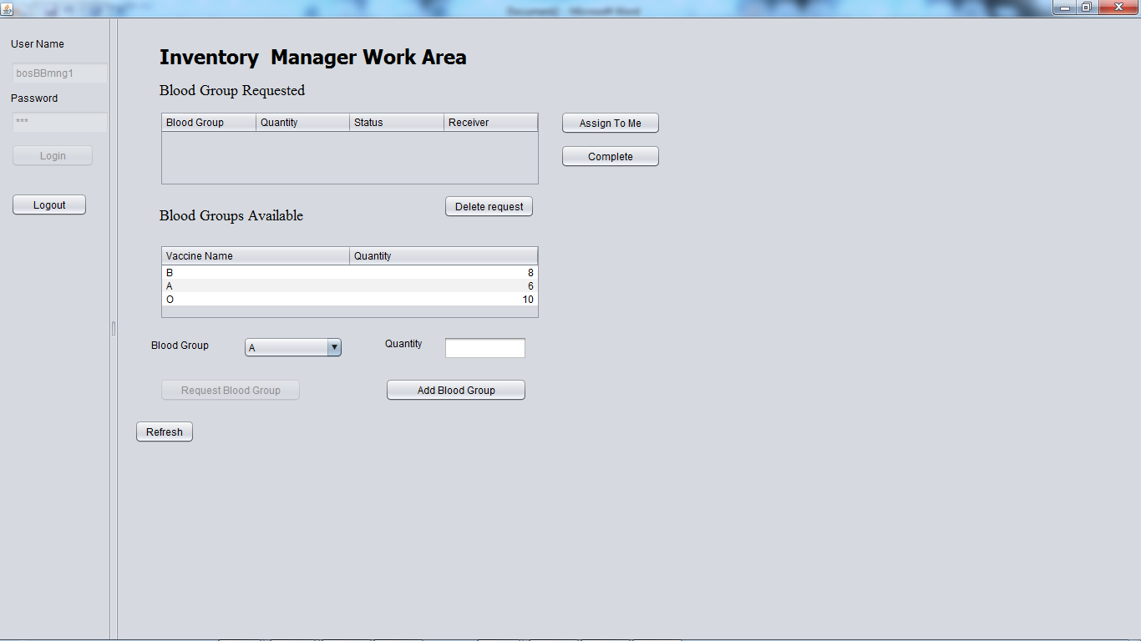
Blood Bank Inventory Manager Workarea

Slide 13
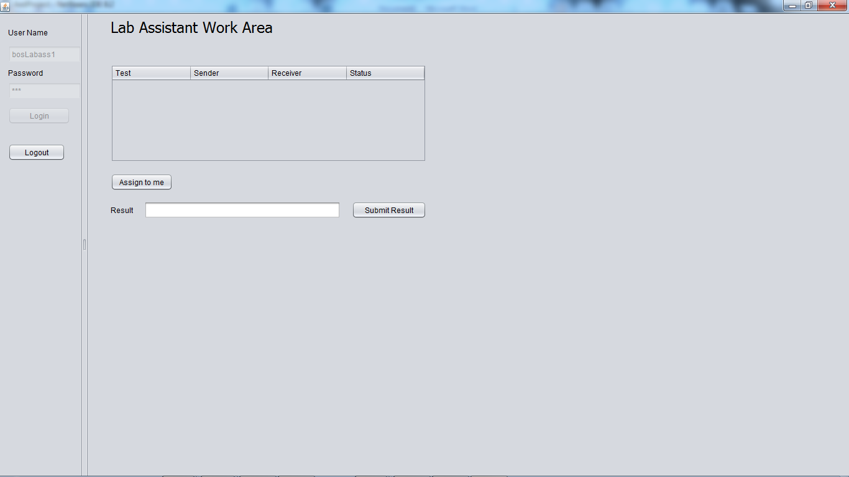
Lab Assistant Work Area

Slide 14
Work Queue Requests

Slide 15
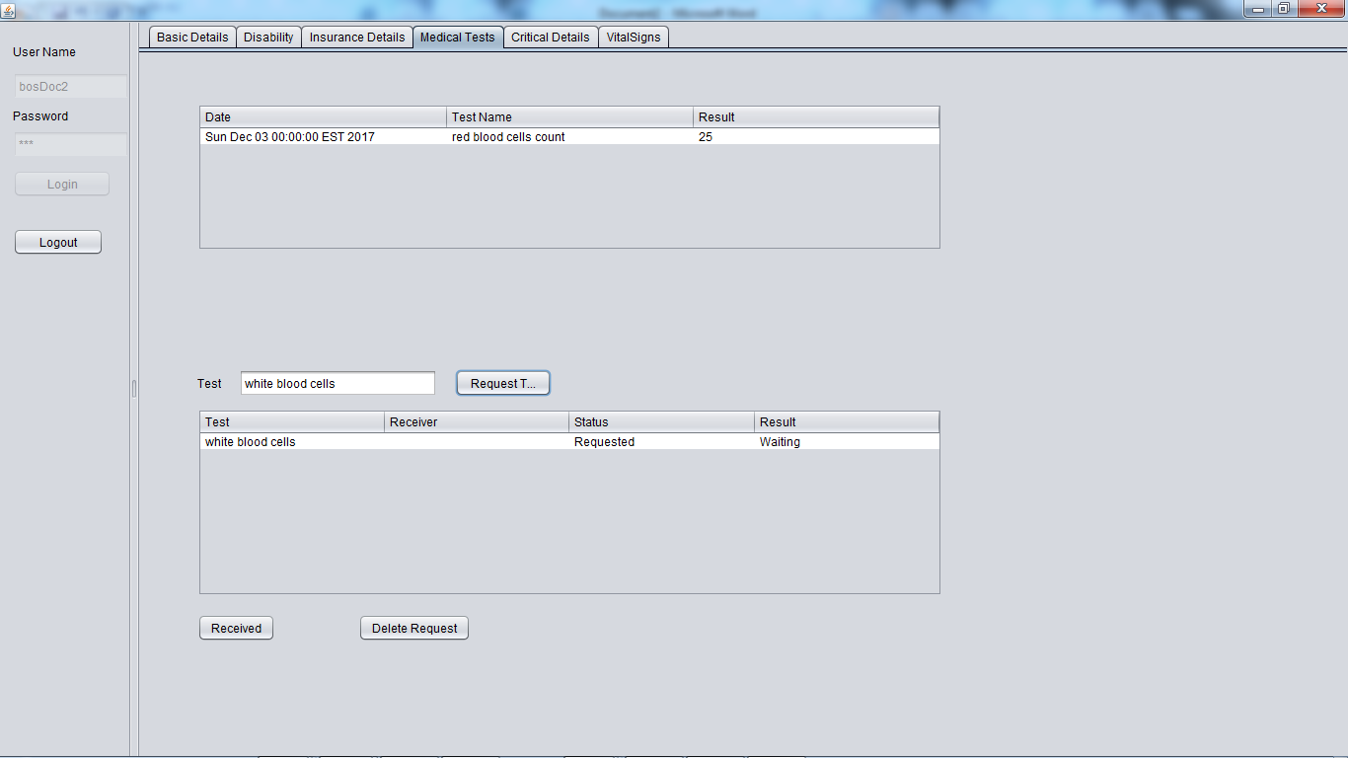
Medical Test Work Queue

Slide 16
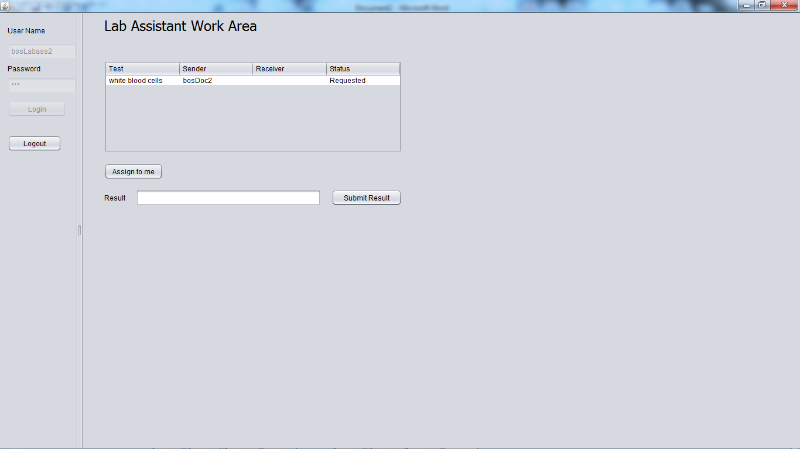

Slide 17
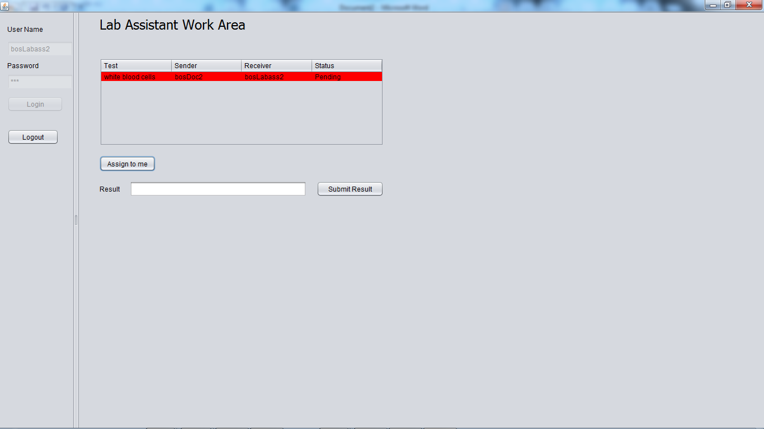

Slide 18
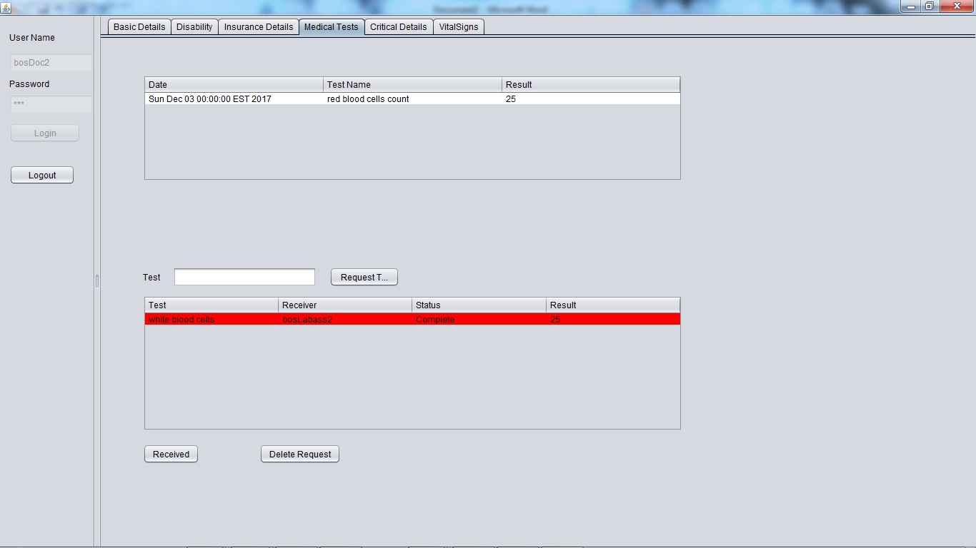

Slide 19


Slide 20
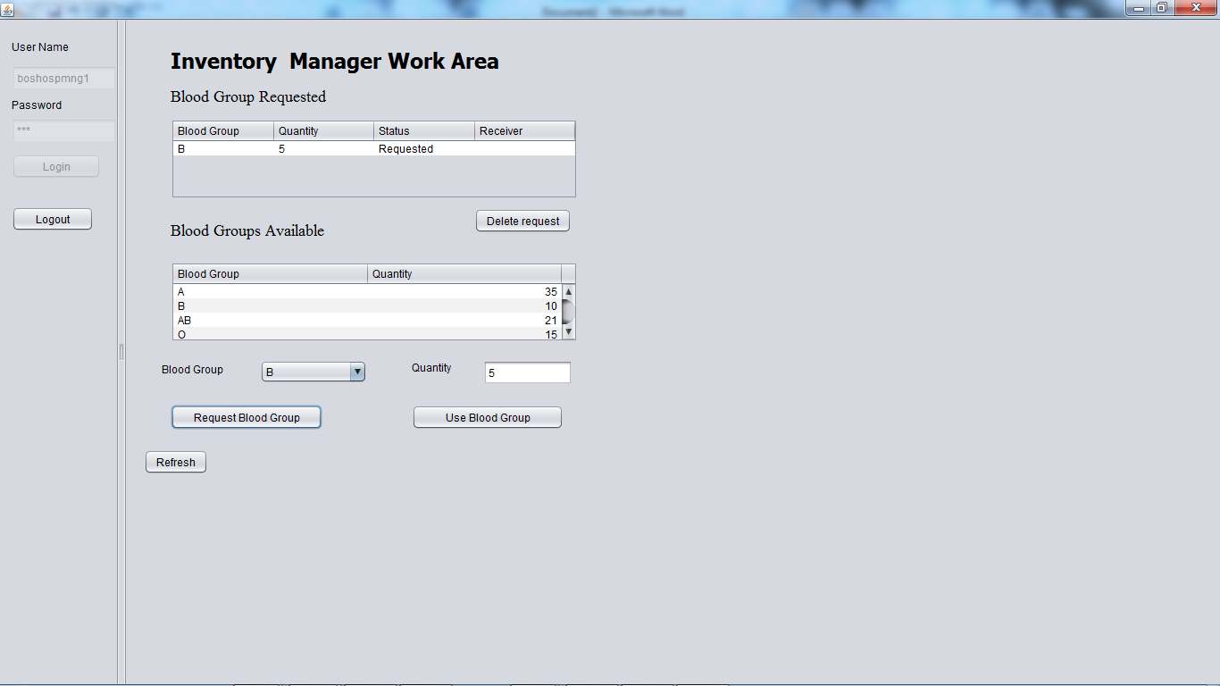
Blood Group Work request

Slide 21
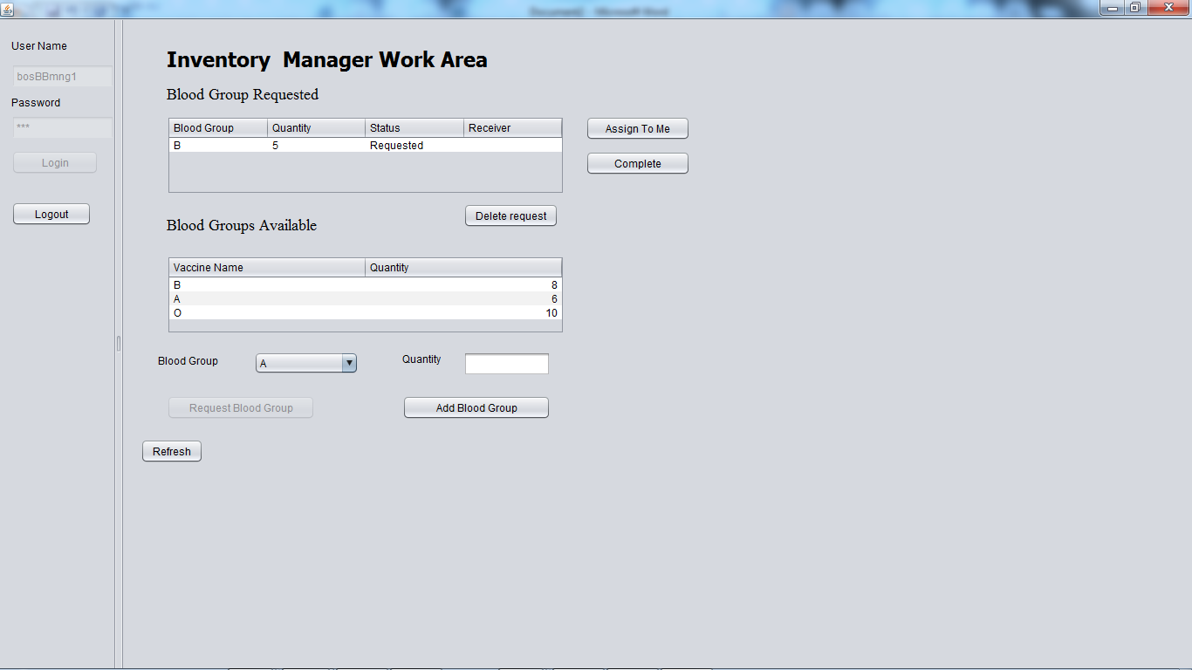

Slide 22
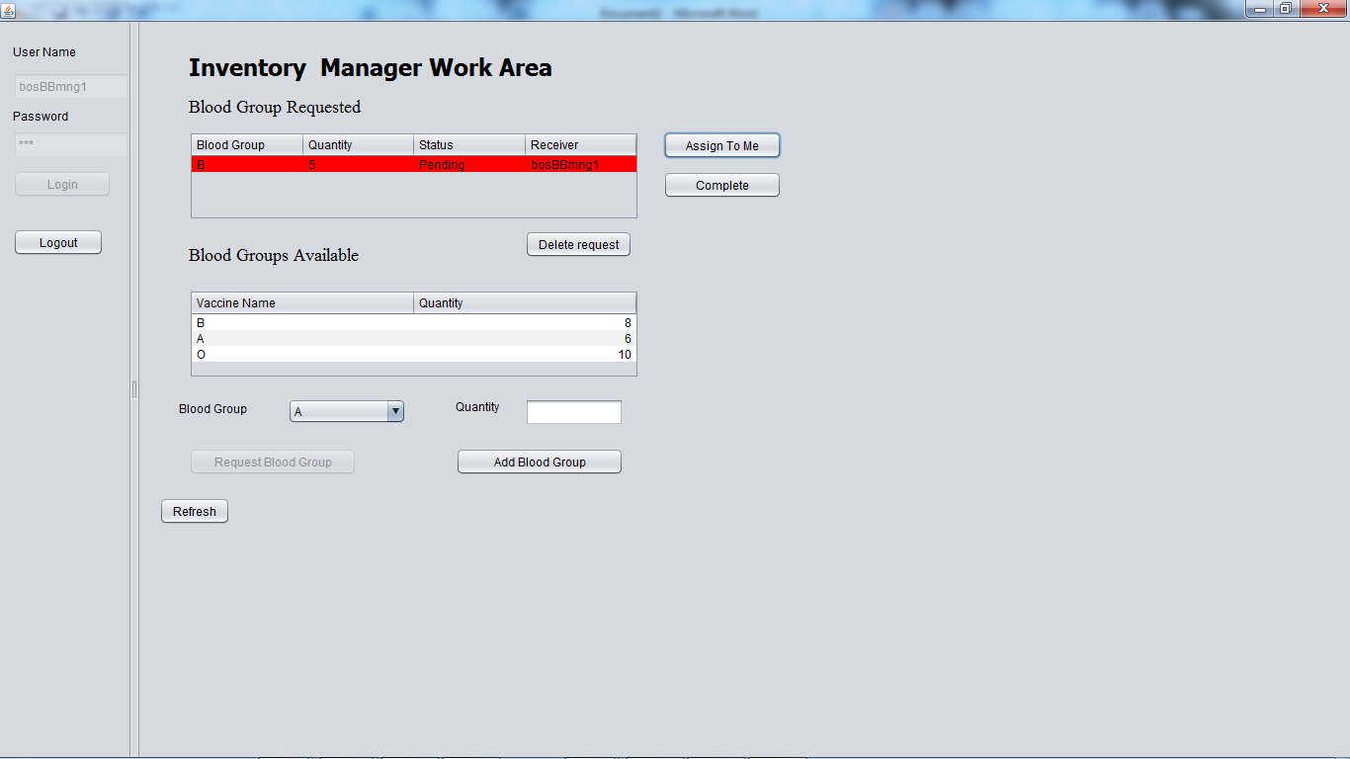

Slide 23
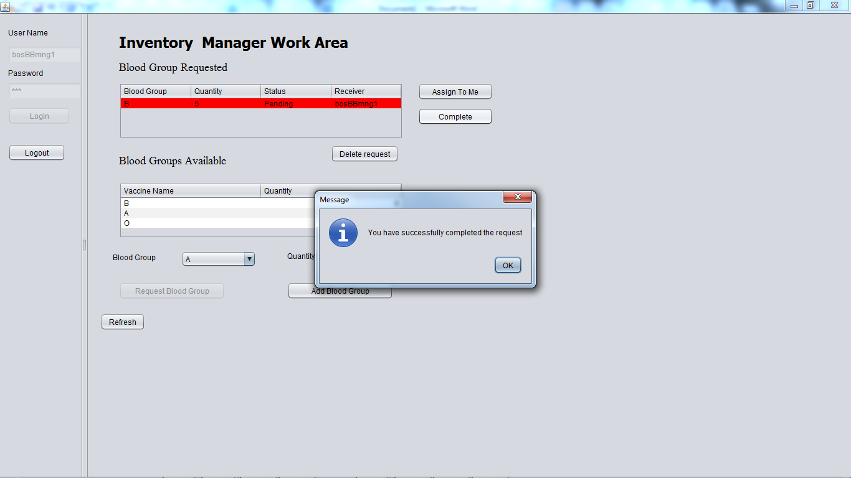

Slide 24
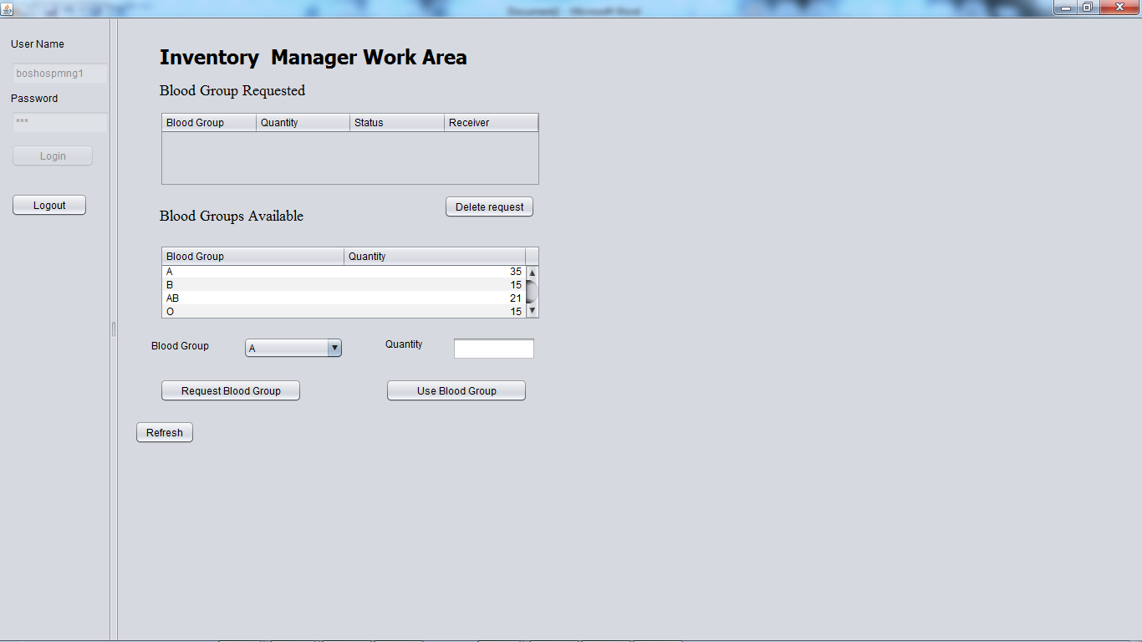

Slide 25
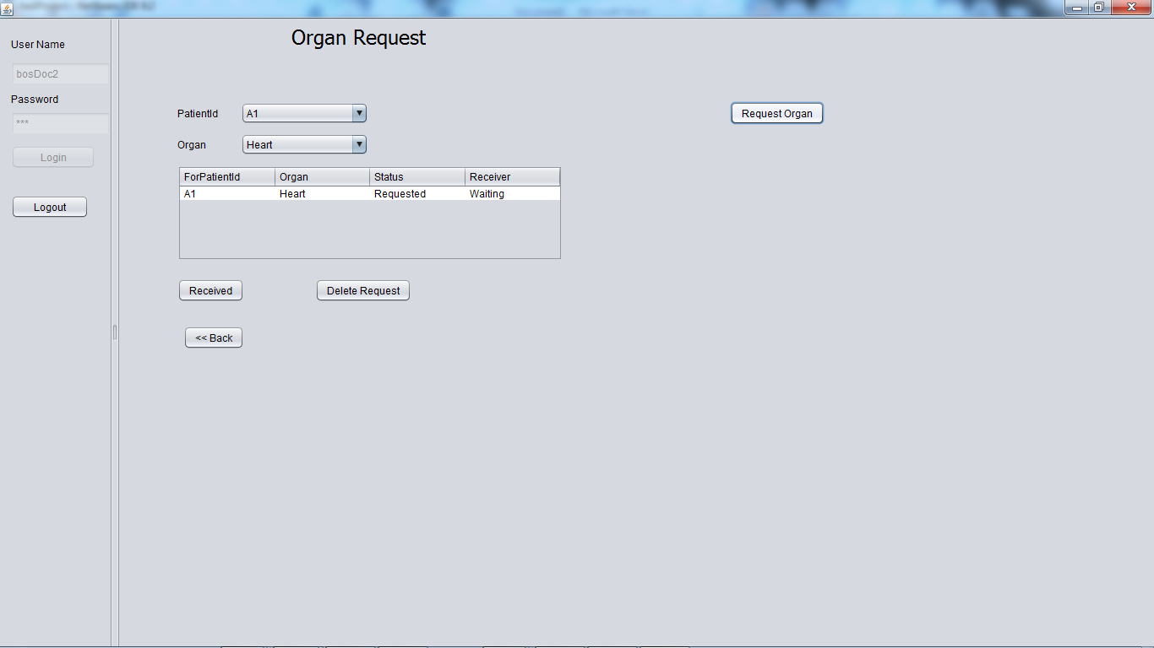
Organ Work Request

Slide 26
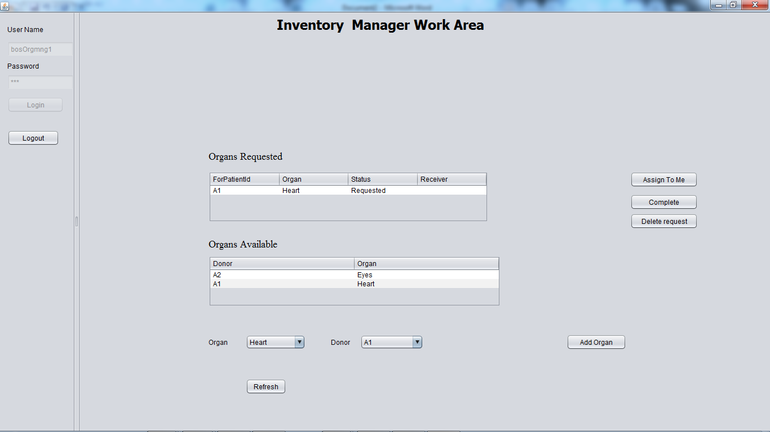

Slide 27
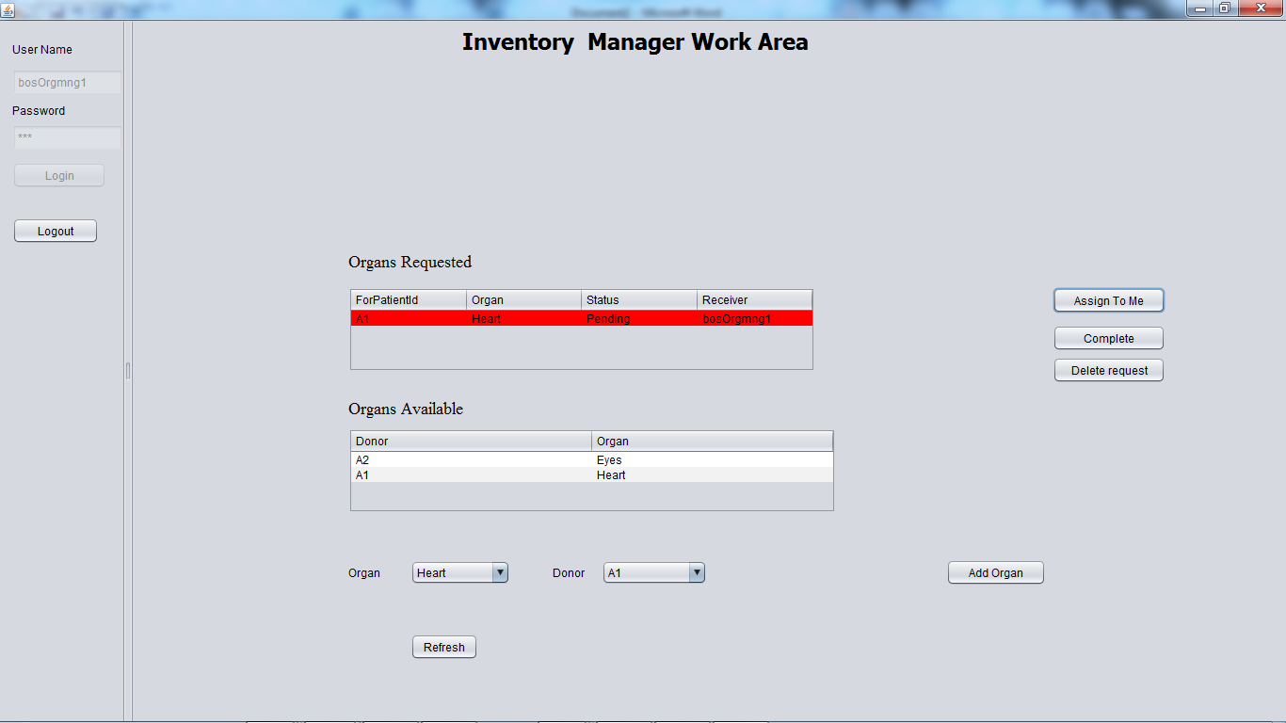

Slide 28
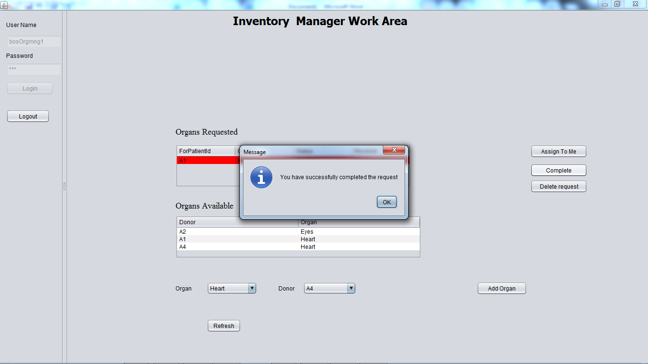

Slide 29
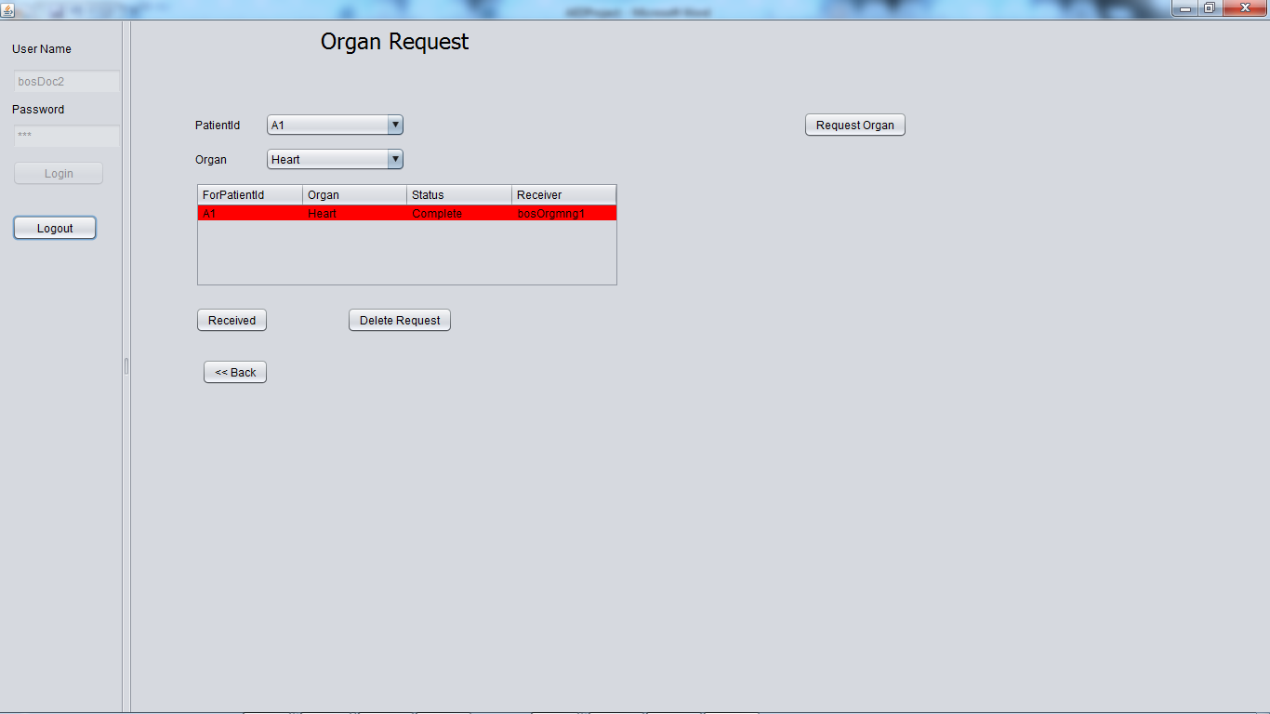

Slide 30
Statistics

Slide 31
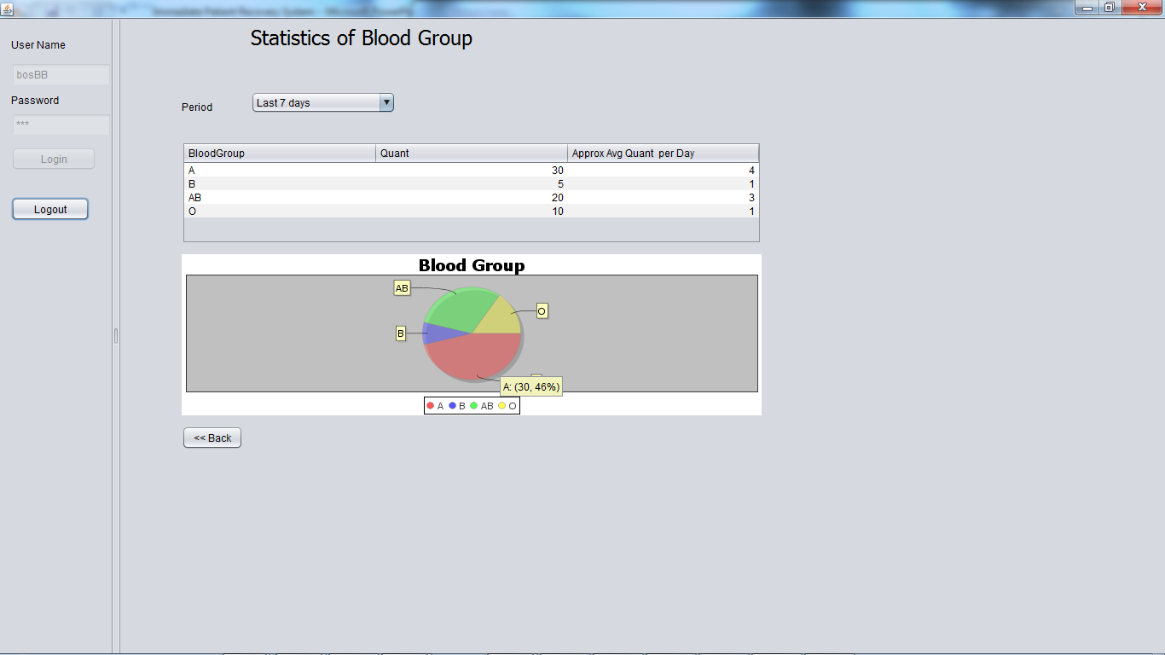
Blood Group

Slide 32
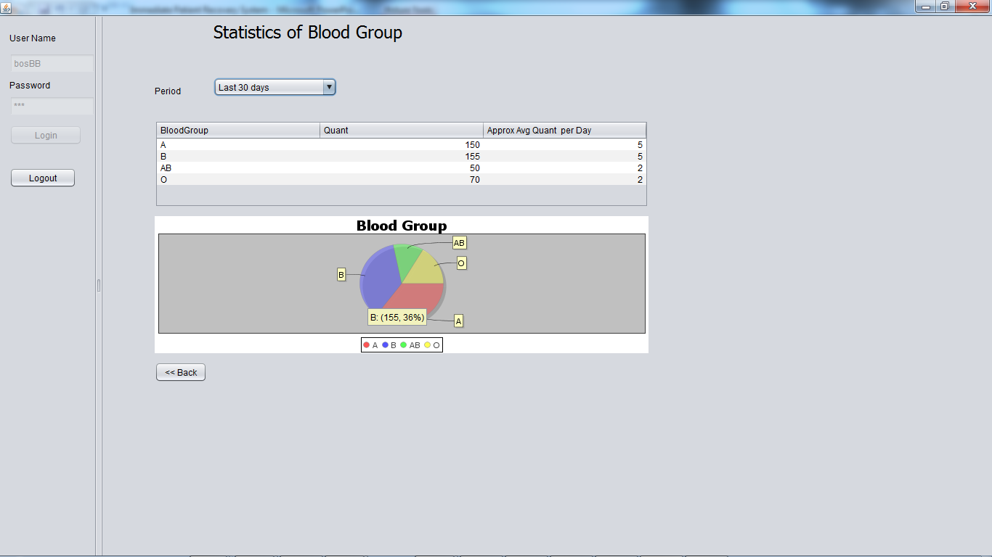

Slide 33
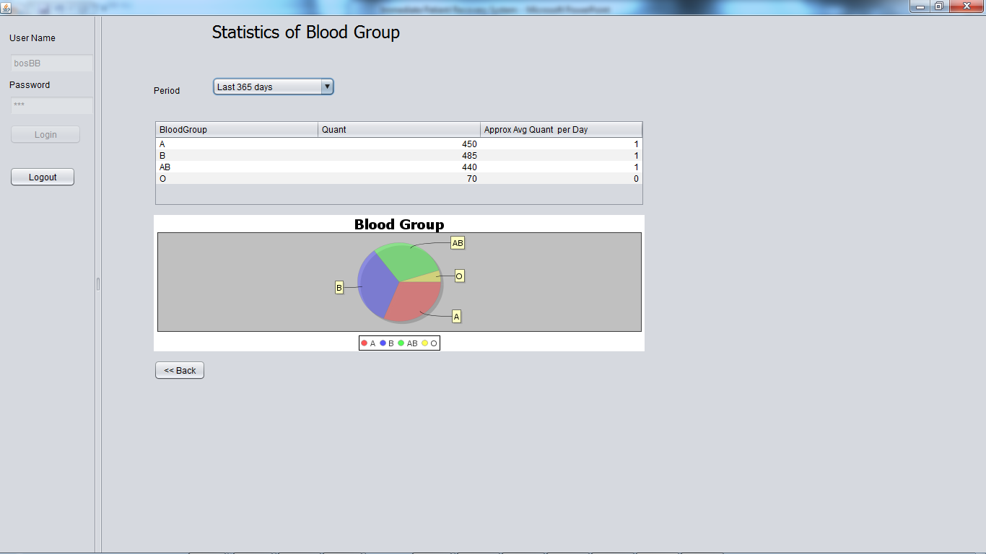

Slide 34
Project Demo

Slide 35
Thank You !

